Slide 1
ACTION PLAN:
SOLAR PANEL CLEANSING DRONE
IMAGE DETECTION AND POSITION IDENTIFIER
FLIGHT CONTROLLER, SIMULATION AND AERODYANAMICS
ESCs, ORIENTATION, CLEANSING PARTS AND 3D DESIGN
Image detection using raspberry pi zero and pi camera. The postion of the solar panel and the landing postion is is also calculated.
ANAND THAKUR
YACHU RAJA JOSHI
Flight controller using atmega 32A microcontroller. Simulations for calculating speed of each motors for movement and rotation of the drone.
SHREEJAN SINGH SILWAL
SKEIN NEUPANE
Esc from scratch, self balancing using gyroscopes and accelerometer and cleansing rotors along with 3d design of frames and other parts.
SUSHANT PANDAY
SAKAR PATHAK

Slide 2
Setting up the quadcopter
1-The quadcopter has inbuilt sensors to calculate Altitude.
2-Inertial Measurement Unit,made up of a accelerometer which measures linear acceleration and a gyroscope that measures angular rate.
3-From the IMU, and our knowledge of acceleration due to gravity, we can estimate the Minidrone’s altitude relative to gravity and how fast it’s rotating.

Slide 3
Actuators
-Actuators are components that convert energy into mechanical motion in order to move or control a mechanism or system.
-We have 4 actuators in the quadcoptor system i.e. the 4 motors and their propellers
The most important thing to recognize with these motors is their configuration and spin direction.

Slide 4
Spin direction
-Opposing motors spin in the same direction as each other, but the opposite direction as the other pair.
-This is necessary to make sure that thrust, roll, pitch, and yaw can be commanded independently of each other. That means we can command one motion without affecting the others.

Slide 5
System States
System states are things like angular position and rates, altitude, and horizontal velocity.
The states that we are estimating depend on the control architecture and what we are trying to accomplish.

Slide 6
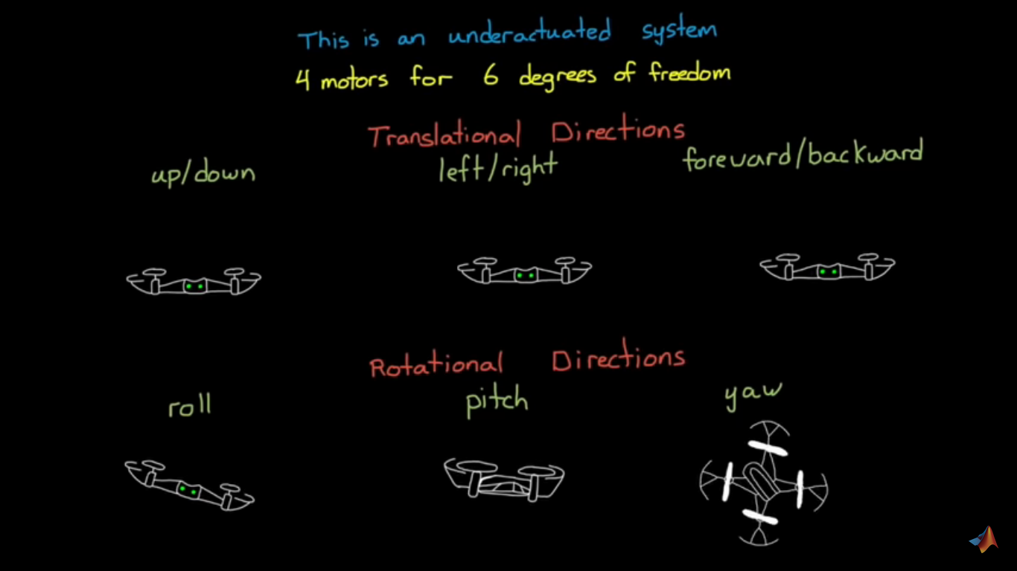
Degree of freedom
We only have 4 actuators, but we have 6 degrees of freedom
three translational directions ---
up and down
left and right
forward and backwards
Three rotational directions
Roll
Pitch
yaw

Slide 7
Since we don’t have an actuator for every motion, then we already know that some directions are uncontrollable at any given time.
As a example, our minidrone is not capable of moving left, at least not without first rotating in that direction. The same goes for forward and backward motion as well.

Slide 8
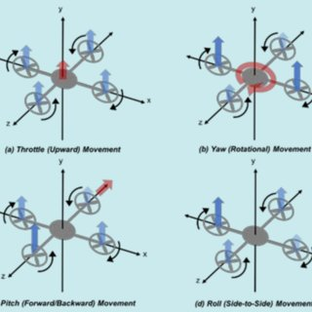
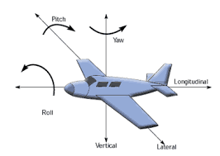

Slide 9
Kinematics of quadcopter
A motor produces thrust by spinning a propeller which pushes air down, causing a reaction force that is up.
If the motor is placed in a position that the force is applied through the center of gravity of an object, then that object will move in pure translation, no rotation at all. And if the force of the thrust is exactly equal to and opposite of the force of gravity then the object will hover in place.
A force at a distance from the center of gravity produces both a translational motion as well as a torque, or rotating moment around the center of gravity.

Slide 10
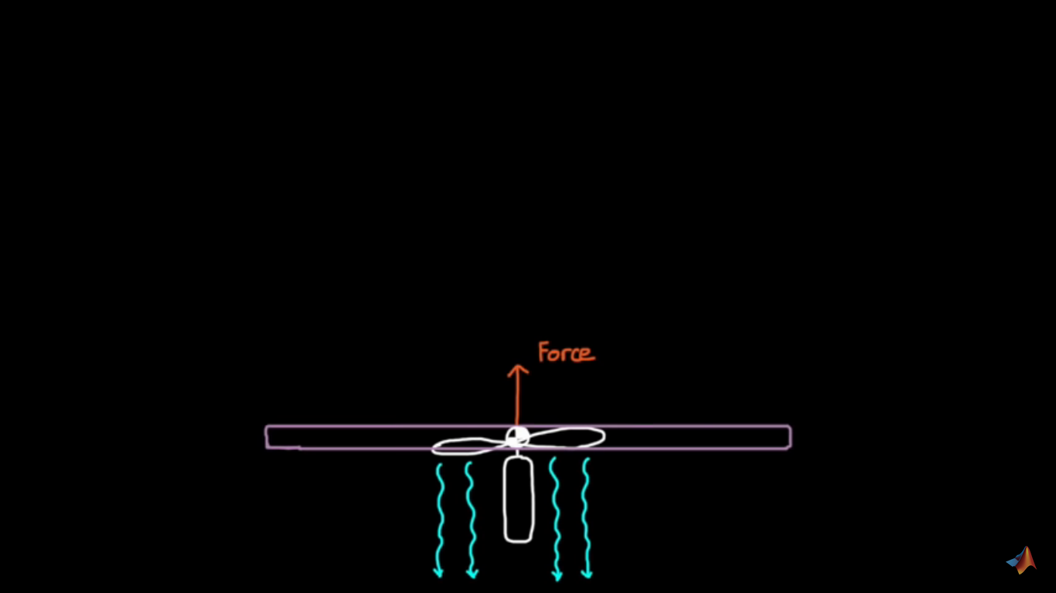
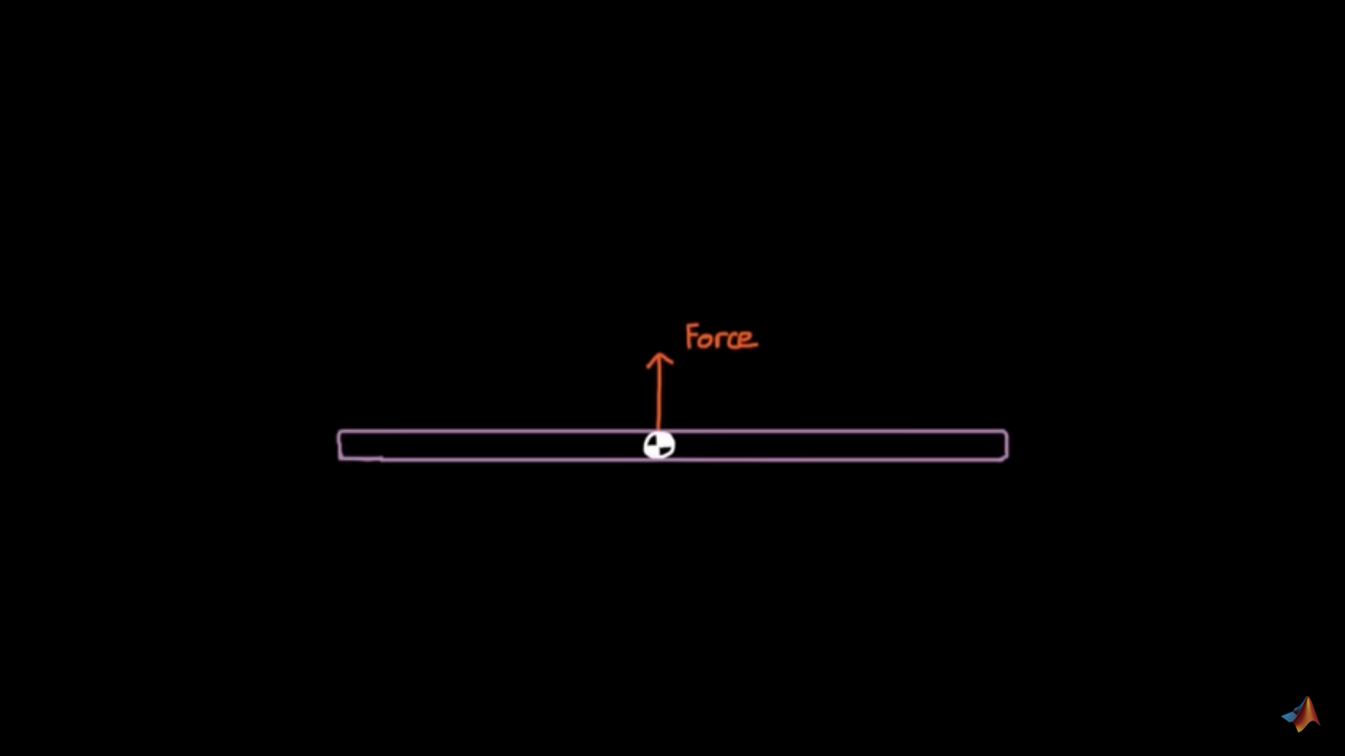
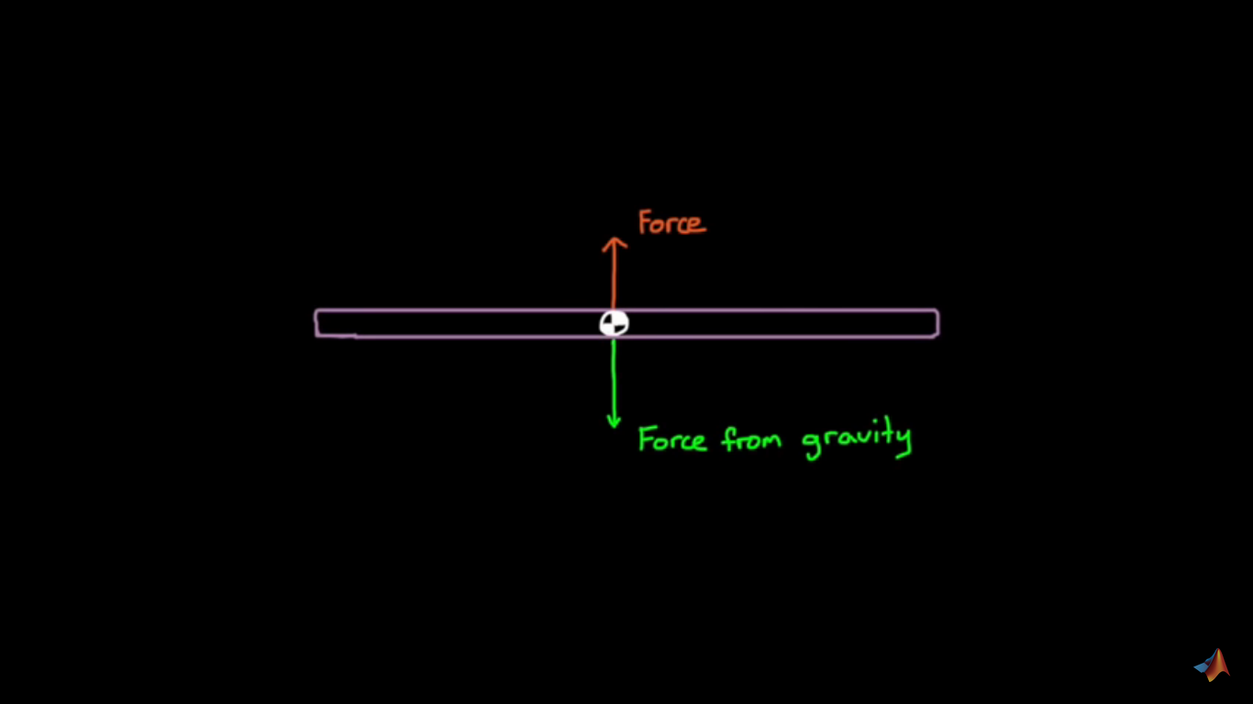
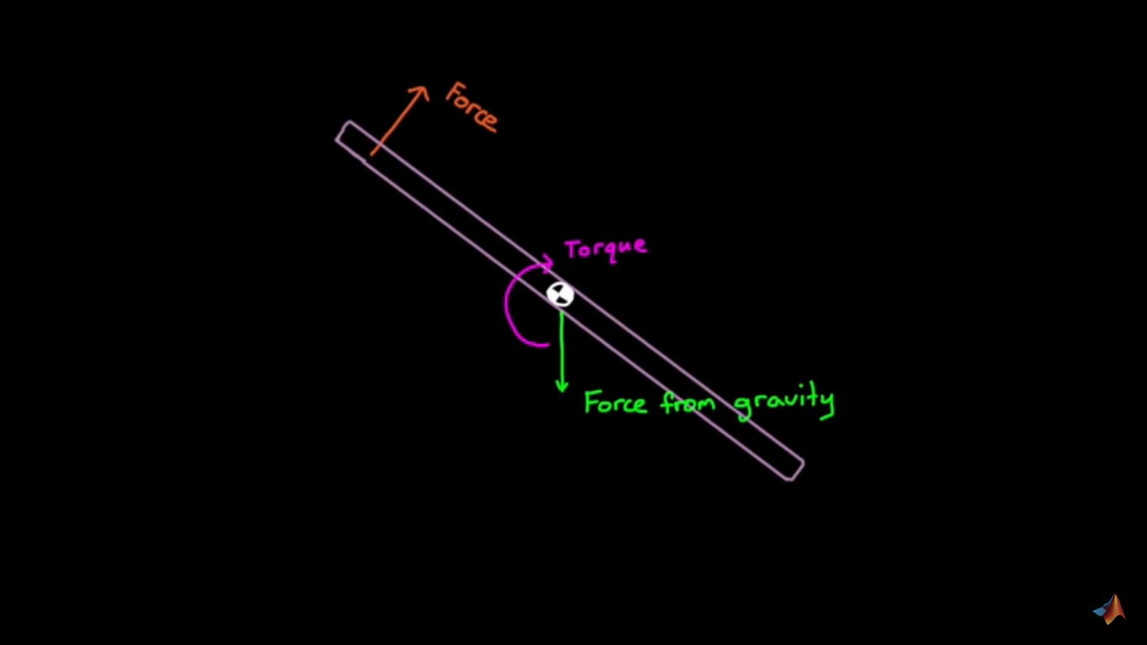

Slide 11
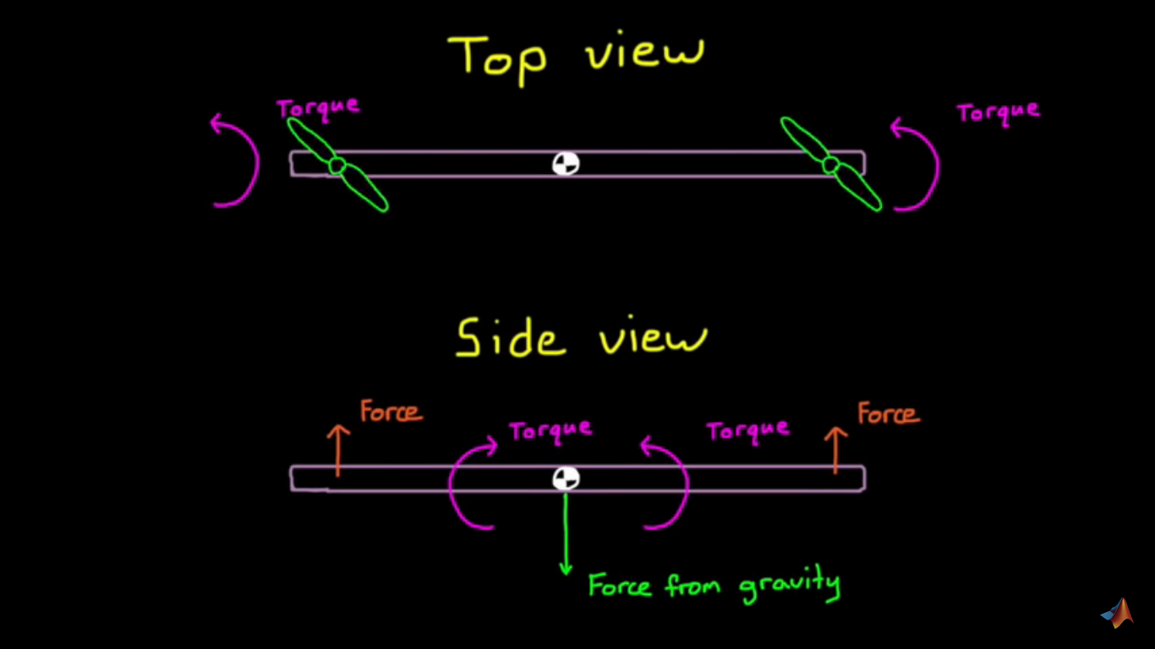

Slide 12
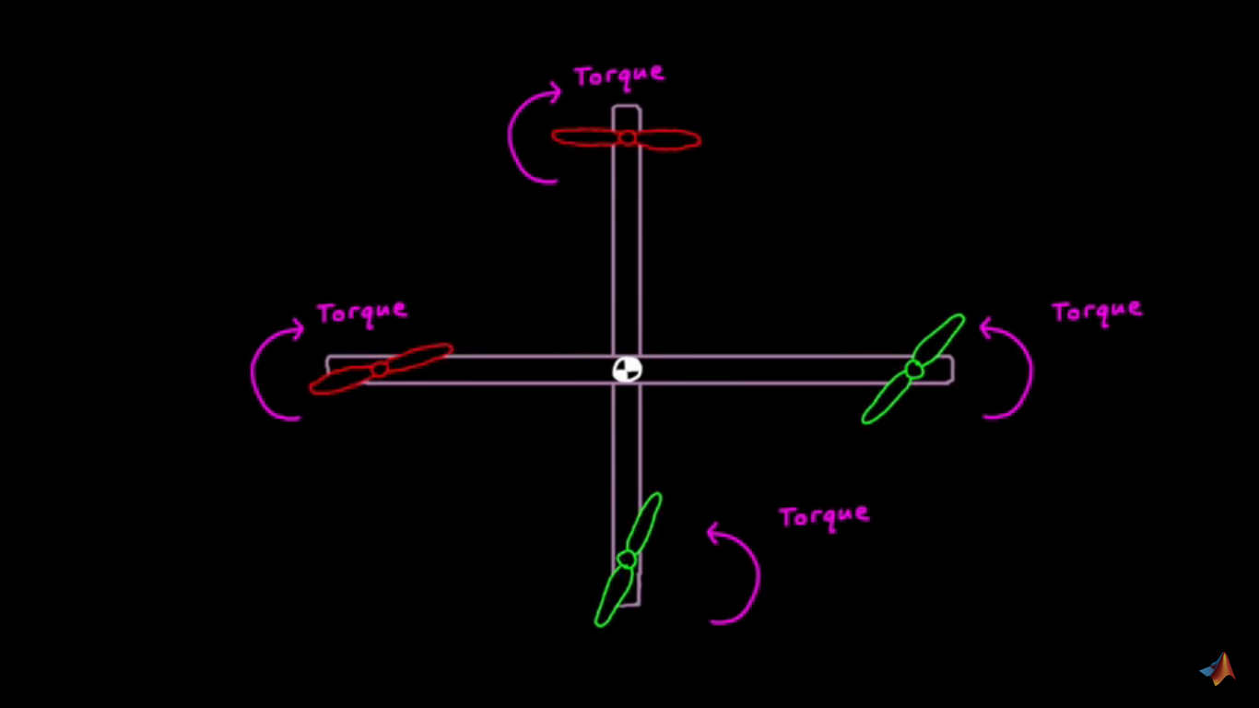

Slide 13
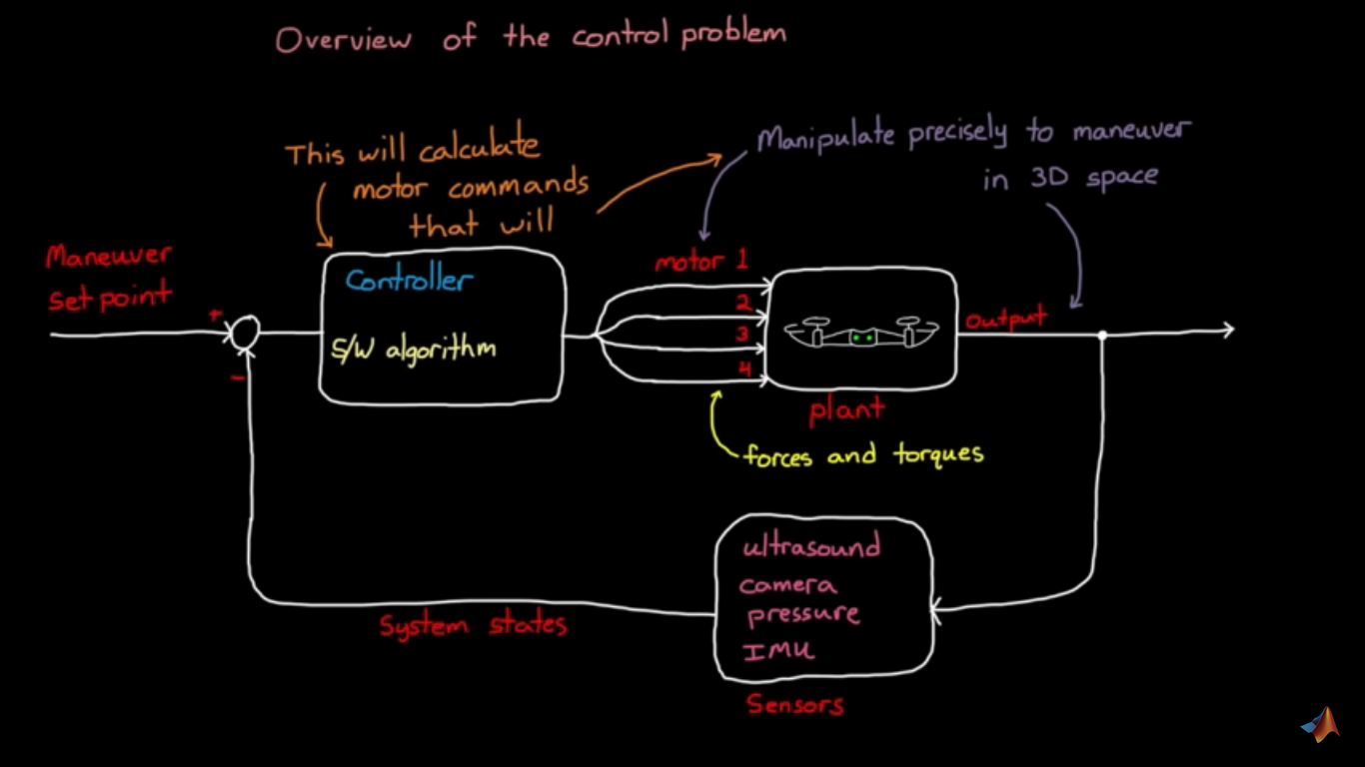

Slide 14
Control system architecture
To figure out which states we need to feedback, how many controllers we need to build and how those controllers interact with each other.

Slide 15
Feedback Controller
If we want to increase thrust, you’d speed up all four motors by moving the two toggles in this direction.
Yaw requires that two opposing motors increase speed and the other two decrease speed so that yawing left, for example, would require this kind of toggle motion.
Then to roll the vehicle, increase one of the left/right pairs, and decrease the other.
And to pitch the vehicle, increase one of the front/back pairs and decrease the other.
In this way, we, as the feedback controller, could get the drone to hover by expertly changing the commands to these four motors.

Slide 16
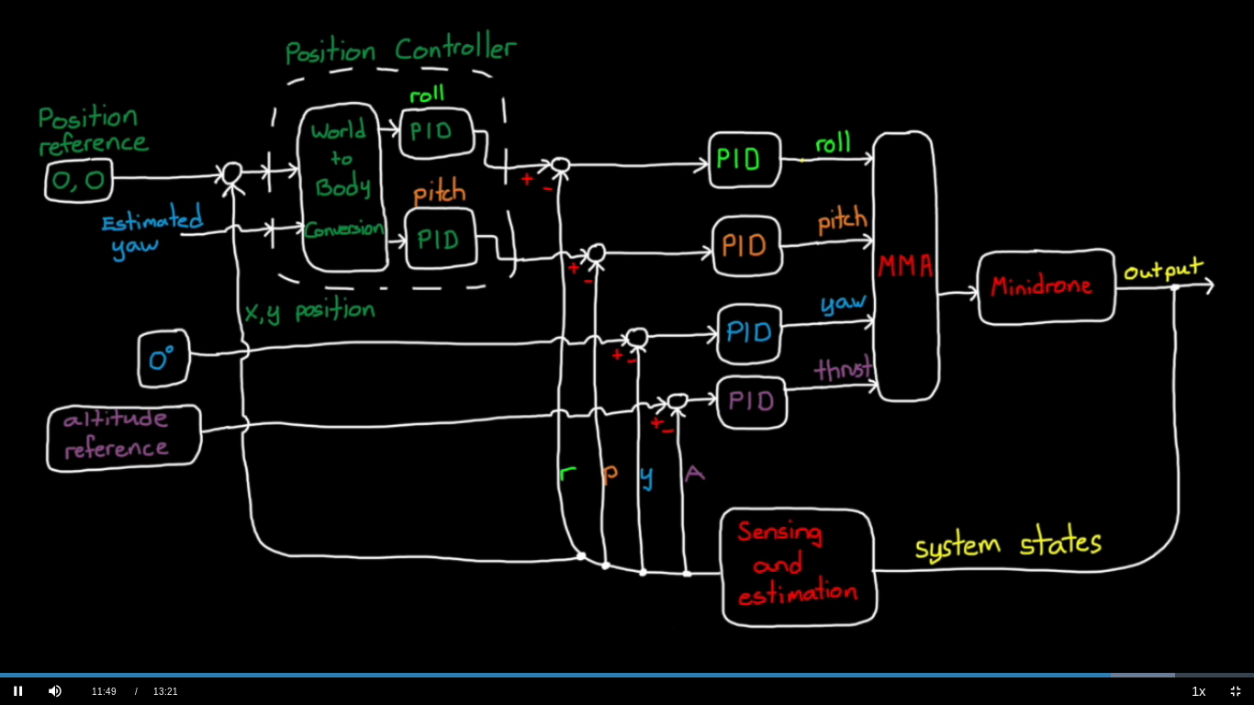

Slide 17
S.N. | COMPONENTS | RATE | QUANTITY | TOTAL COST
1. | Brushless motor | $20-$40 | 4 | $80-$160
2. | Propeller | $0.5-$2 | 4 | $2-$8
3. | Components for ESCs | $2-$5 | 4 | $8-$20
4. | MPU6050 | $1 | 1 | $1
5. | Atmega 32A | $2.5 | 2 | $5
6. | Raspberry pi zero | $5 | 1 | $5
7. | Pi camera | $30-$50 | 1 | $30-$50
8. | Dc motor | $3-$5 | 2 | $6-$10
9. | Miscellaneous | $40-$60 | N/A | $40-$60
Total cost |  |  |  | $177-$319

